Slide 1

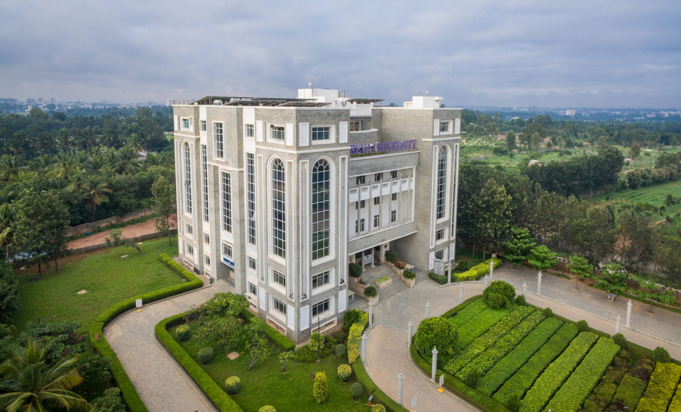
ELECTION ANALYSIS USING MACHINE LEARNING
Presented By:
Md Kaif Mustafa (R21EJ020)
Rahul Kumar Singh (R21EJ026)
CSIT “A”- 6th Sem
Under the Guidance: Prof. Pavan Kumar Naik

Slide 2
CONTENTS
ABSTRACT
INTRODUCTION
LITERATURE SURVEY
PROBLEM FORMULATION
METHODOLOGY
RESULTS
CONCULSION AND FUTURE SCOPE

Slide 3
ABSTRACT
This project, "Analyzing and Predicting Election Outcomes in Indian Politics," employs data mining and machine learning techniques to unravel the complexities of electoral dynamics. It explores candidate attributes, party affiliations, and historical trends, enhancing predictive accuracy through algorithms like Decision Trees, Random Forests, SVM, and XG Boost. Note worthy contributions include SVM optimization through grid search and a thorough comparative study of model performance. Visualizations shed light on the relationships between winning candidates and demographics. Acknowledging successes and limitations, the project navigates the challenges of model interpretability in political contexts, presenting a nuanced exploration of election prediction in Indian politics.

Slide 4
INTRODUCTION
Elections form the bedrock of democratic processes, and understanding the intricate dynamics that influence their outcomes is crucial. In the realm of Indian politics, where diversity and complexity abound, our project endeavors to unravel the underlying patterns and factors that contribute to election results. Leveraging a rich dataset encompassing candidate details, party affiliations, demographics, and election results, we employ advanced machine learning techniques to derive valuable insights and predictions.

Slide 5
LITERATURE SURVEY
The Emergence of Social Media Data and Sentiment Analysis in Election Prediction
This paper explores the use of social media data and sentiment analysis for predicting election outcomes, focusing on Twitter data as a valuable source for real-time insights into public sentiment and opinions. The method involves reviewing and summarizing various research approaches, including volumetric analysis, sentiment analysis, and machine learning techniques. Although specific performance metrics are not provided, the paper notes that past studies have demonstrated varying degrees of success in election prediction using these methods, contingent on factors such as data volume, sentiment analysis accuracy, and machine learning algorithms. Ultimately, the research underscores the increasing significance of social media data and sentiment analysis in the realm of election forecasting, opening doors to novel avenues for grasping public sentiment. It recognizes the hurdles that necessitate further exploration and utilization in the field of political analysis.

Slide 6
LITERATURE SURVEY
Comparing Sentiment Analysis of Indonesian Presidential Election 2019 with Support Vector Machine and K-Nearest Neighbor Algorithm
This research addresses the problem of predicting the outcome of the 2019 Indonesian presidential election through sentiment analysis of Twitter data, comparing the performance of Support Vector Machine (SVM) and K-Nearest Neighbor (KNN) machine learning algorithms. The methodology involves data collection, extensive text preprocessing, TF-IDF weighting, and sentiment classification using SVM and KNN. The advantage lies in leveraging machine learning to gain insights into public sentiment during a significant political event, offering practical implications for political analysis. Performance evaluation criteria, encompassing accuracy, precision, recall, and F1-score, were utilized to gauge the effectiveness of SVM and KNN, ultimately demonstrating SVM's higher level of accuracy. To summarize, SVM surpassed KNN with an average accuracy of 69.27%, underscoring the significance of choosing the right algorithm in text classification endeavors and pointing toward promising directions for future research.

Slide 7
PROBLEM FORMULATION
The problem statement of this project, "Analyzing and Predicting Election Outcomes in Indian Politics," revolves around the challenge of developing effective predictive models to discern the complex dynamics influencing election results in the Indian political landscape. The primary objectives are to explore patterns within candidate details, party affiliations, demographics, and historical election outcomes. The project aims to address class imbalance, enhance model interpretability, and provide actionable insights for political stakeholders.
The exploration of the models' ability to generalize from historical data to predict outcomes in future elections, considering the evolving nature of political scenarios. Overall, the problem statement encapsulates the intricacies of predicting election results in a diverse and dynamic political environment, aiming to contribute valuable insights for stake holders and policy makers.

Slide 8
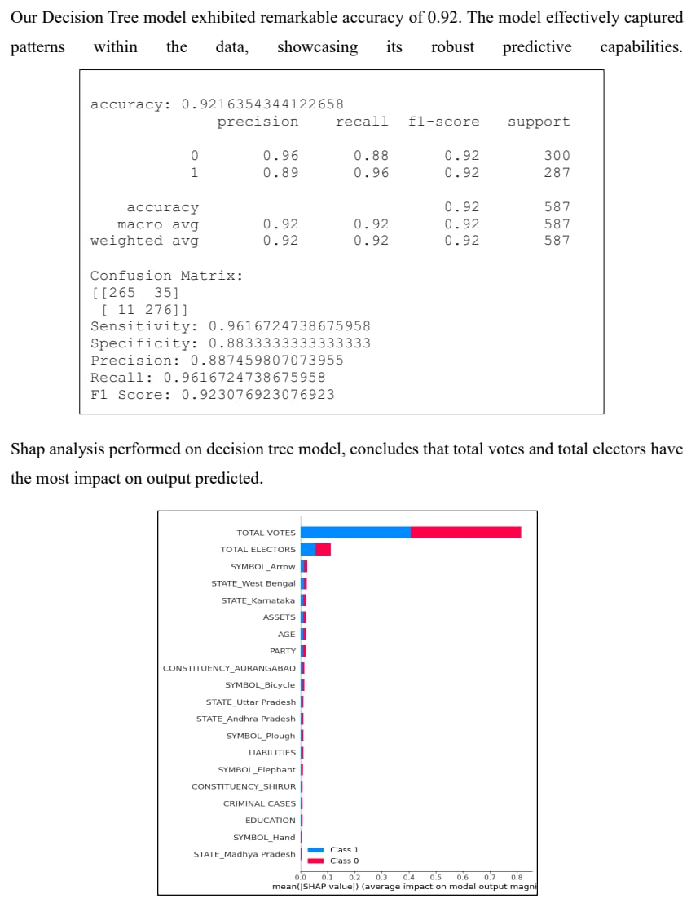
METHODOLOGY

Slide 9
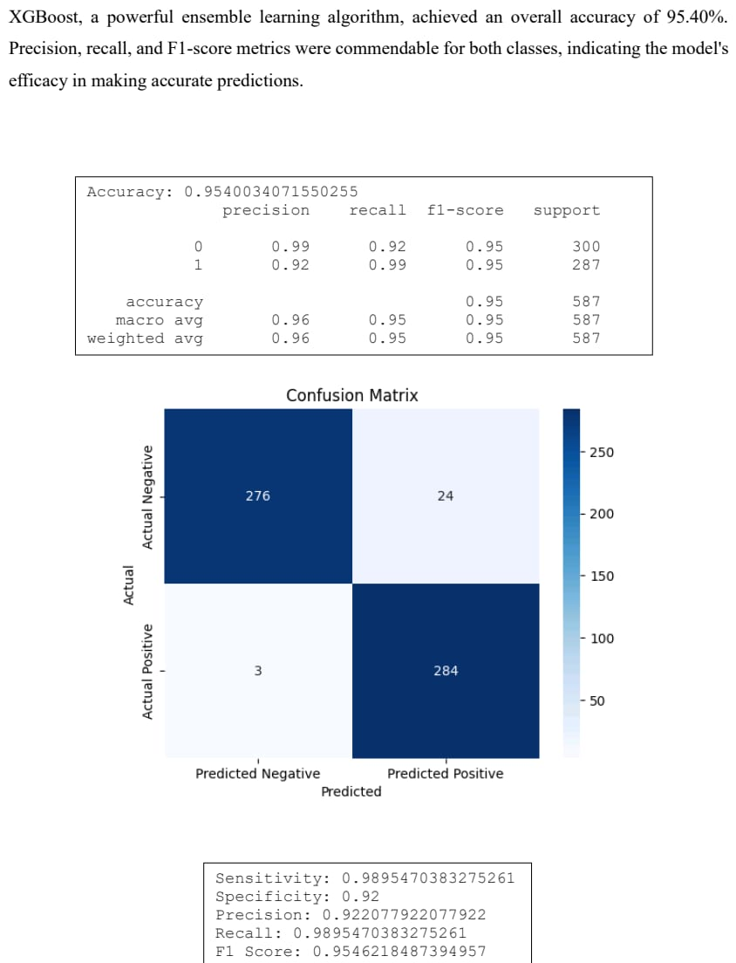
METHODOLOGY

Slide 10
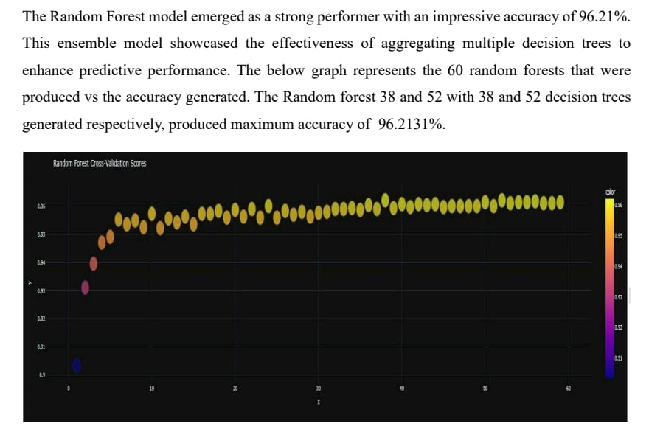
METHODOLOGY

Slide 11
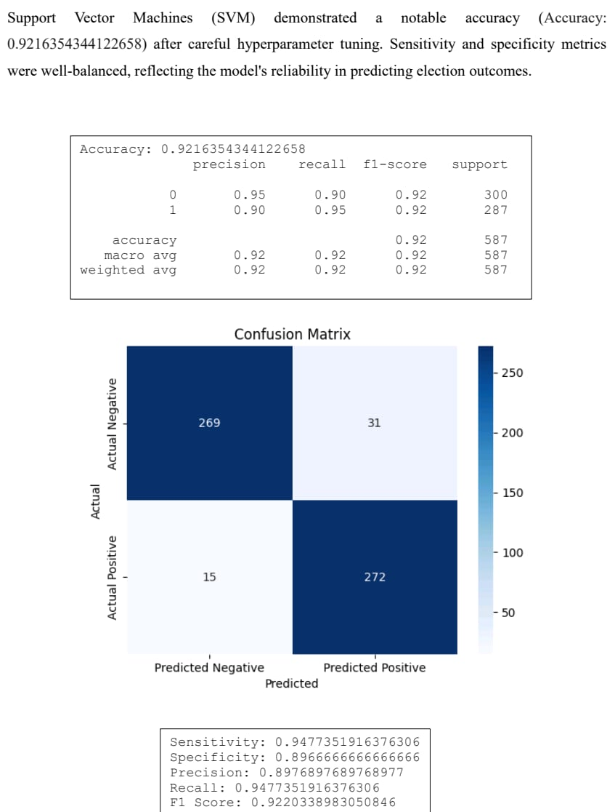
METHODOLOGY

Slide 12
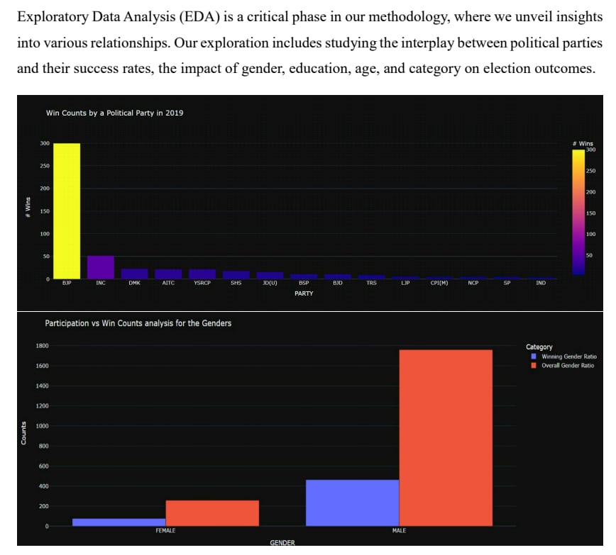
RESULTS

Slide 13
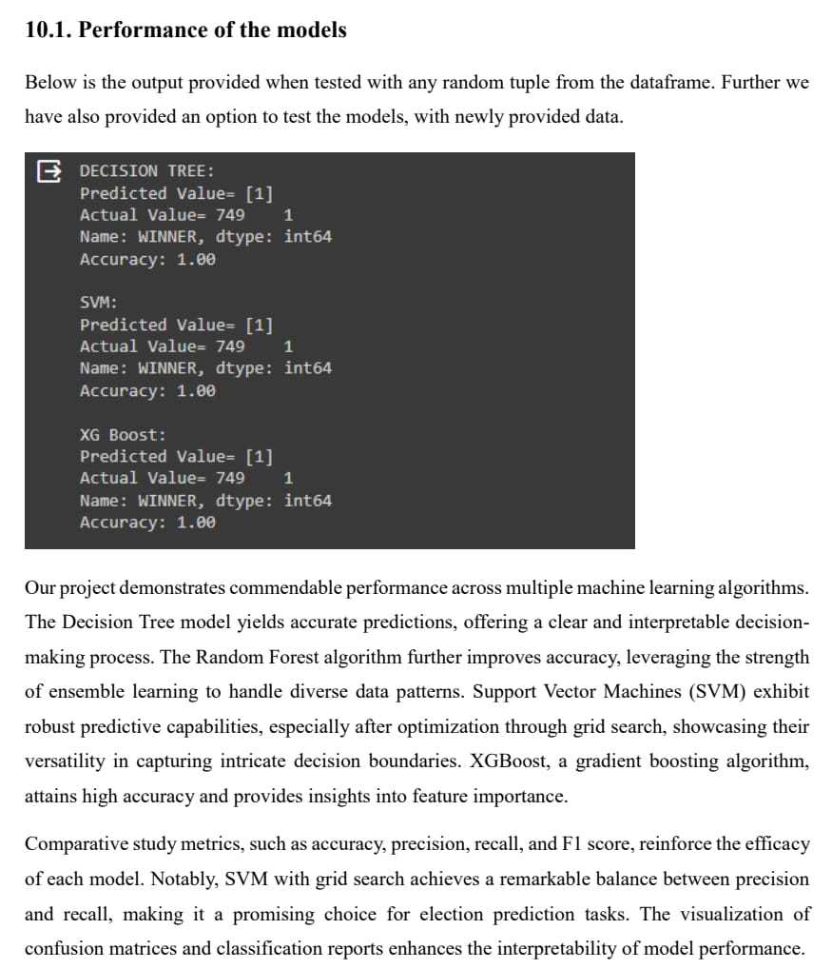
RESULTS

Slide 14
CONCULSION AND FUTURE SCOPE
In conclusion, our project successfully addresses the complex task of predicting election outcomes in the multifaceted landscape of Indian politics. The application of SHAP values enhances model interpretability, shedding light on the factors contributing to election results. Up sampling techniques effectively address class imbalance, ensuring robust and balanced predictive models. The comparative study of machine learning algorithms reveals the strengths and limitations of each, offering valuable insights for political strategists and policymakers. Our project contributes by not only providing accurate predictive models but also by offering a transparent understanding of the intricate dynamics governing election outcomes.

Slide 15
CONCULSION AND FUTURE SCOPE
The systematic organization of our project, including the literature survey, problem statement, and detailed methodology, ensures a comprehensive exploration of the subject. The performance metrics and comparative study emphasize the efficacy of our models, providing a solid foundation for future research in the realm of election prediction.
For future Scope , we envision extending our analysis to include temporal dynamics, considering the evolving nature of political landscapes. Additionally, exploring ensemble models or hybrid approaches could offer further improvements in predictive accuracy. Incorporating sentiment analysis from social media and news sources might provide a real-time perspective on voter sentiments. Finally, collaboration with political scientists and domain experts could enrich our models with domain-specific insights, contributing to a more holistic understanding of election dynamics.

Slide 16
THANK YOU

